Slide 1
THE TUTORIAL BUILDER SYSTEM
George Cherian-6408
Neil Chettiar-6409
Omkar Narkar-6438

Slide 2
Contents
Abstract
Project Overview
Problem Statement
Functional Requirements
Non-Functional Requirements
Project Design and Architecture
Technologies used
Implementation Details
Test Cases & Output
Current Status
Further Work
Project Timeline
Conclusion and Future Work
References

Slide 3
Abstract
The Tutorial Builder System is being built as a solution to the long standing problem of learning topics via the internet being a rather difficult and arduous process.
With all the information needed to properly understand a topic scattered about multiple pages and sometimes the pages which hold information in an easy to understand format may not even be found.
Thus our system aims to solve this problem by crawling the internet for data relevant to a single topic and then appropriately ranking it based on a set of criteria and passing the highest ranked tutorial out of all the raw data found to the user so that he may easily understand the topic by only looking through a single website which holds all the necessary information.

Slide 4
Project Overview
The Tutorial Builder System is a software based system which will use data collection algorithms, data ranking algorithms, word processing and data merging algorithms to find the data regarding a certain topic and then sort through the data on the topic, combine all of the data in a easy to understand and intuitive manner.
The user will give an input to the system in the form of the stream and subject followed by the topic. Our system will search through the databank for the appropriate tutorial and give it to the user to read the data from the databank.
The back end of the system will compile the data for the databank, by reading the data from various sources and then processing them appropriately and storing the data within the databank.

Slide 5
Problem Statement
Data in today's world is spread out over thousands of different places
No limit to the number of places holding information
No guarantee to the grade or relevance of the information
Combine all data to a single location after judging relevant information.

Slide 6
Functional Requirement Analysis
User Registration with facility to enter multiple details.
Make the user choose a default stream of enquiry
User should be able to search for subjects in various streams with default stream always being chosen stream
User should be able to modify details of account
User should be able to specify a topic within a subject to search for
If user is not sure of which topic he wants or wants multiple topics in a subject the system should provide the user with a list of all topics under the system.
User should be able to view and sort search history
User should be able to view previously made searches.

Slide 7
Non-Functional Requirement Analysis
Searches should be fast
Details of every user should be private unless otherwise specified by the user.
Data should be coherent
Tutorials should be easy to understand.
System should be reliable
System should not be vulnerable to attacks.

Slide 8
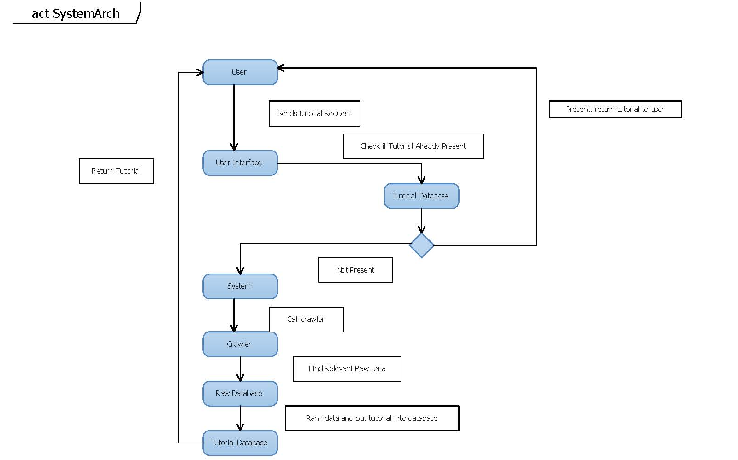
Project Design and Architecture

Slide 9
Technologies Used
Python-
Libraries-
urllib2
SGMLParser
requests
HTTPError
re(Regular Expression)
MySQL
JAVA
JSP
HTML
GlassFish Server
NetBeans
PyCharm

Slide 10
Implementation Details
We created a shell environment in which to run the entire project
The shell environment consists of a database of crawlable pages which
emulate the internet.
We collect a set of relevant files from the crawlable pages using the subject name entered by the user.
Then we find the terms which are common to these set of pages and save these as ‘relevant terms’.

Slide 11
Implementation Details
Once we have the relevant terms we look through the crawlable
database again and find all the data which have a relevancy score higher
than a threshold limit
The relevancy score is calculated by searching through the data
with respect to the terms
Once we have the most relevant pages we apply the ranking algorithm

Slide 12
Implementation Details
The Ranking Algorithm ranks the pages based on 5 criteria:
Ease Of Understandability.
Diagrams
Descriptivity
Examples
Comments
The highest ranking document is then selected and stored in the cache database.
From here, the generated tutorials are used for clients with similar search criteria.

Slide 13
Experimental Value Derivation
a term that is in 60% of the selected documents is relevant and when 60% is chosen as a term threshold we get the maximum number of relevant terms as well.

Slide 14
Experimental Value Derivation
As the graph shows the % of relevant documents initially increase with a higher threshold but on taking a higher threshold value the % of relevant documents decreases our experiments lead us to take the termdata threshold as 5.

Slide 15
Experimental Value Derivation
The lower the threshold the higher number of irrelevant documents that enter into the data ranking algorithm and are considered for the final tutorial but if the threshold value is too high then we might end up ignoring tutorials which are good and relevant enough to the topic

Slide 16
Test Case-1 Input and Pre-Loaded Data
Input
Stream:Computers
Subject:java
Crawlable Database

Slide 17
Test Case-1 Intermediate Data
The Subjects list
The Documents from which we derive the terms

Slide 18
Test Case-1 Intermediate Data
The terms list

Slide 19
Test Case-1 Intermediate Data
The documents and the relevancy score

Slide 20
Test Case-1 Intermediate Data
Data Scores for data id:9
: Ease Of Understandability :10.62962962962963
: Diagrams :0
: Descriptvity :1.0
: Examples :0.0
: Comments :0
: Relevancy Score :12.118959107806692
: Total Score :23.74858873743632
Data Scores for data id:11
: Ease Of Understandability :10.37593984962406
: Diagrams :0
: Descriptvity :2.0
: Examples :0.0
: Comments :0
: Relevancy Score :11.38013698630137
: Total Score :23.75607683592543

Slide 21
Test Case-1 Intermediate Data
Data Scores for data id:12
: Ease Of Understandability :10.114942528735632
: Diagrams :0
: Descriptvity :3.0
: Examples :0.0
Info: Comments :0
Info: Relevancy Score :13.386666666666667
Info: Total Score :26.5016091954023
Data Scores for data id:13
Info: Ease Of Understandability :10.306122448979592
Info: Diagrams :0
Info: Descriptvity :2.0
Info: Examples :0.0
Info: Comments :0
Info: Relevancy Score :11.761006289308176
Info: Total Score :24.067128738287767

Slide 22
Test Case-1 Intermediate Data
Data Scores for data id:15
Info: Ease Of Understandability :10.304347826086957
Info: Diagrams :0
Info: Descriptvity :4.0
Info: Examples :0.0
Info: Comments :0
Info: Relevancy Score :11.209016393442623
Info: Total Score :25.513364219529578
Data Scores for data id:16
Info: Ease Of Understandability :10.75
Info: Diagrams :0
Info: Descriptvity :3.0
Info: Examples :0.0
Info: Comments :0
Info: Relevancy Score :9.889705882352942
Info: Total Score :23.639705882352942

Slide 23
Test Case-1 Final Output
The Final Tutorial Selected BY Maximum Score
Data -12
Total Score :26.5016091954023

Slide 24
Test Case-2 Input,Pre-Loaded Data and Output
Input
Stream:Computers
Subject:java
Cache Database
The data chosen directly from the cache is
Data id:12

Slide 25
Current Status
Currently, the tutorial builder application is run in a controlled and simulated environment.
The environment consists of a test set of pre-searched and relevant study materials.
Along with these relevant study materials, there are also non-relevant materials.
The Web Crawler is implemented in this environment and it successfully sorts through and selects the relevant files and saves these into another Database.
The Tutorial Builder then ranks these selected files using its ranking algorithm and generates the best tutorial in the end.

Slide 26
Further Work
Further work includes the expansion of the project to the internet.
Options to allow the client to enter specific topics within the subject of a particular stream, to help provide a more refined search result and tutorial generated.

Slide 27
Project Time Line
September 2014
Conceptualized the possible design and platform on which the application would work.
Identifying the various components and technologies that would be required for this application.
Identifying the possible limitations of the tutorial builder application and its implications.

Slide 28
Project Time Line
October 2014
Researching the logic behind ranking of data
Finding the currently used algorithms present for the multiple modules like crawling data
Formulating the databases needed and other logical parts of the system

Slide 29
Project Time Line
November-December 2014
Developing and successfully implementing the focused Web Crawler.
Formulated our data ranking algorithm and its ranking parameters.
Implemented and successfully tested multiple word frequency corpuses for our ranking algorithm.
Finalized on a 3 way divided text corpus for the ease of understandability criteria that is used in our data ranking algorithm.

Slide 30
Project Time Line
January 2015
Design of the Project interface.
Creating the various databases and their connections to the front end.
Designing and implementing our simulated working environment for the working and testing of the tutorial builder.

Slide 31
Project Time Line
February 2015
Implementation of a web crawler which crawls the internet and takes data which is relevant to the system
Implementation of a web application which deals with user input and simulated environment

Slide 32
Conclusion & Future Work
As seen from our testcases, the Tutorial Builder App works well within the controlled testing environment.
In the future, the project will be opened to the general internet to search for and sort through available study material.
We can include machine learning into the applications so that it can extract only relevant information from websites, making the data ranking and crawling more efficient.

Slide 33
References
Automated Essay Scoring Using Machine Learning - Shihui Song, Jason Zhao
A Machine Learning Approach to WebpageContent Extraction - Jiawei YaoDepartment ofCSStanford University, XinhuiZuoDepartment of MS&EStanford University
SubjectivityWord Sense Disambiguation - CemAkkaya and JanyceWiebe University of Pittsburgh, RadaMihalceaUniversity of North Texas
A New Approach to Design Domain Specific Ontology Based Web Crawler - DebajyotiMukhopadhyay, Arup Biswas, Sukanta Sinha
A Scalable Ranking Method for Semantic Web Data with Context –
Context based Re-ranking of Web Documents (CReWD) - Arijit Banerjee, JagadishVenkatraman Graduate Students, Department of Computer Science, Stanford UniversityAidan Hogan, Andreas Harth, and Stefan Decker
Text Categorization with Support Vector Machines: Learning with Many Relevant Features – Thorsten Joachims

Slide 34
THE END

